Slide 1


Slide 2
Wisdom Quote
Raise your words, not voice. It is rain that grows flowers, not thunder
— Jalaluddin Mohammad Rumi (Islamic scholar, poet, sufi, 1207-1273)
– Winston Churchill (1874-1965, Prime Minister of United Kingdom)

Slide 3

IDEOLOGY & CONSTITUTION OF PAKISTAN

Slide 4
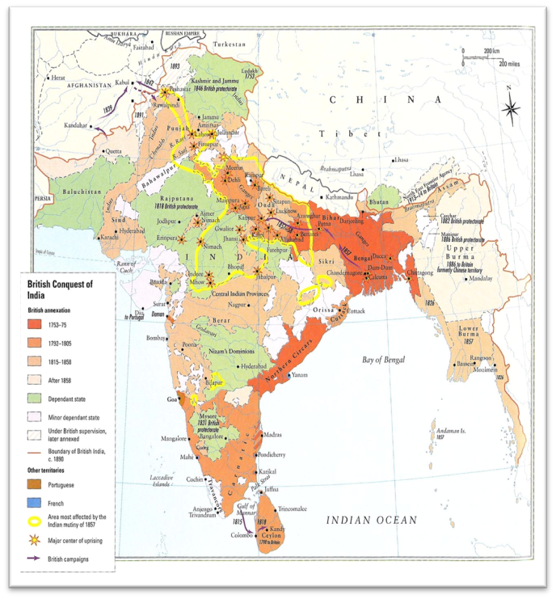

Agenda for Today
Two-Nation Theory
Political and constitutional developments in Sub-continent (1940-44)

Slide 5
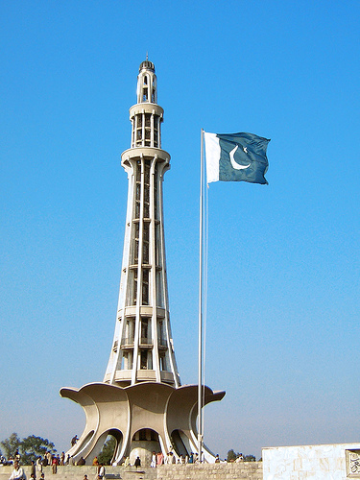

Pakistan Resolution (1940)
During the March 22-24, 1940 Muslim League annual session, held at Minto Park (now Minar-e-Pakistan) in Lahore, under the chairmanship of Quaid-e-Azam the Pakistan Resolution was passed
The Quaid in his address at the session once again highlighted the need for a separate homeland for the Sub-continent Muslims
--continued

Slide 6
Pakistan Resolution (1940)
The Quaid reiterated Muslims in India were no minority, and Muslims, Hindus have entirely different civilizations
On March 23, A.K. Fazlul Haque presented the resolution, which was backed by many prominent leaders on the occasion; the resolution while representing Muslims' basic rights in clear terms demanded a separate state comprising regions with Muslim majority (areas: Sindh, Punjab, Balochistan, KP)
The Pakistan Resolution endorsed the Two-Nation Theory emphatically
--continued

Slide 7
Pakistan Resolution (1940)
While the Hindus opposed the Resolution, the Indian Muslims hailed it (an indirect proof of the contrasting ways of the TWO NATIONS!)
Following the passing of the Resolution, Indian Muslims under the dynamic, intelligent leadership of Quaid-e-Azam now had one and only one aim: PAKISTAN
Muslims in India got united at Muslim League platform
Muslim League's policy now onwards was crystal clear: partition of India
The untiring efforts, sacrifices of Muslims and exemplary leadership of the Quaid proved decisive in achieving PAKISTAN – in the next seven years

Slide 8

Two-Nation Theory: Pakistan's Ideology
Ideology is the very base for the formation of a society
Ideology: A set of beliefs, values, norms, symbols, goals and practices incorporated into generalised conceptualisations about a good society
These conceptualisations cover prominent social, economic and political relationships

Slide 9

Two-Nation Theory
Ideology of Pakistan is established upon the ideals of Islam, i.e. Pakistan is an Islamic state drawing its inspiration and guidance from the Holy Quran, traditions of the Holy Prophet (SAW)
Philosophy of Pakistan Movement indicates Sub-continent Muslims' love for Islam; 'Islamic Millat' was the basic concept behind Pakistan Movement
Pakistan's ideology prompts its citizens to rise above ethnic, territorial and linguistic differences
--continued

Slide 10
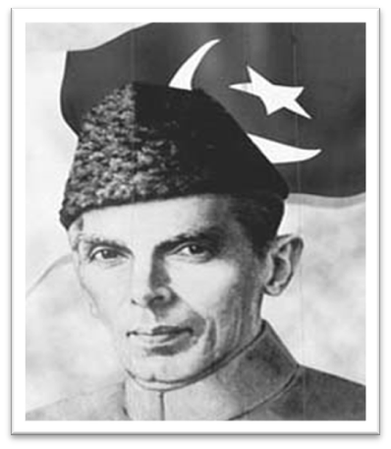
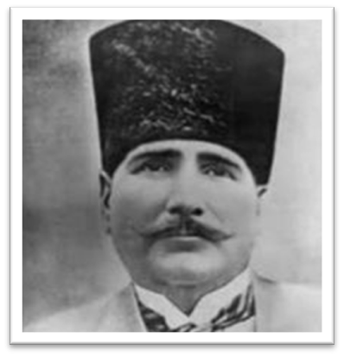
Two-Nation Theory
Quaid-e-Azam Mohammad Ali Jinnah, the Founder of the Nation, and Allama Iqbal were strong proponents of Pakistan's ideology, based on Islamic nationalism
--continued

Slide 11

Two-Nation Theory
Ideology Basis: Hindus and Muslims were two different nations having completely different social, religious, economic, cultural backgrounds, beliefs; Due to this clear, comprehensive difference they were not one nation
Sir Syed, Allama Iqbal and Quaid-e-Azam were convinced Muslims will not be allowed to prosper, in Hindu-majority India, according to their fundamental beliefs; at Allahabad in 1930, Iqbal stressed the need for a separate homeland for Muslims
The theory proved decisive in Pakistan's creation
--continued

Slide 12
Importance of Two-Nation Theory
Cause of Muslims' consciousness not to be part of united India; Muslims realised their importance as a major stakeholder in the Sub-continent
The theory gave Muslims awareness that they were no minority with a big population in the Sub-continent
It was endorsed that the Western model of democracy was not applicable in the Sub-continent
The Congress attitude after 1937 elections exposed its anti-Muslim stance; proved Two-Nation Theory's importance in the creation of the Islamic Republic of Pakistan in 1947

Slide 13
British Offer of 1940 & Civil Disobedience Movement
With Britain faced setback in WW-II in 1940, its govt presented an offer to India regarding its political and constitutional problems; Muslim League neither accepted nor rejected the offer; Congress rejected as its demand for a national govt was not met
Civil Disobedience Movement: In October 1940, Gandhi launched the movement; Muslim League didn't support it, regarding it an effort to highlight Congress as the sole representative of India

Slide 14
Cripps Mission 1942
While Great Britain in early 1942 faced serious setbacks in WW-II at the hands of Japan, British govt under Sir Stafford Cripps sent a mission to India to discuss the constitutional and administrative affairs; mission presented its draft declaration
Muslim League rejected the offer that didn't give full consideration to 1940 Resolution
Congress members of Madras legislature (under Chakravarti Rajagopalacharia), in April 1942, finally recommended accepting PAKISTAN; top Congress leadership rejected the offer; meanwhile, Gandhi had launched 'Quit India Movement', demanding immediate withdrawal of the British from India

Slide 15
Jinnah-Gandhi Talks 1944
As Muslim League demanded division of India, Congress stressed the unity of India and its independence, there emerged a need for Jinnah-Gandhi talks
In 1943, Rajagopalacharia prepared a formula for a settlement between Congress and Muslim League (formula included transfer of power by Britain, formation of interim govt, demarcation of boundaries, transfer of populations, Muslim majority areas, mutual agreements in case of separation)
Gandhi stuck to his 'one-nation in India' stance while the Quaid was firm on 'Two-Nation Theory'; talks failed

Slide 16
Simla Conference 1945 and General Elections 1946
After the Jinnah-Gandhi talks failure, British govt in 1945 presented its own reconciliation proposal; a conference was held at Simla featuring prominent political parties
General Elections 1946: For Congress and Muslim League, it was a matter of 'United India claim v Pakistan claim'; Muslim League recorded huge win in Muslim-majority areas while Congress registered victory in Hindu-majority constituencies thus the DIVISION OF SUB-CONTINENT WAS ENDORSED THORUGH VOTE; and Muslim League's demand for Pakistan was proven correct

Slide 17
Leading to Freedom...
– Quaid-e-Azam’s Delhi Convention 1946
– Cabinet Mission 1946
– Interim Government 1946

Slide 18
June 3, 1947 Plan
In March 1947, Lord Mountbatten replaced Lord Wavell as Viceroy of India; appointment was welcomed by Congress
Mountbatten found India in a state of civil war
On June 3, 1947 he announced that no plan was acceptable on unity of India by parties; announced power to be transferred to two separate govts in the next few months
Aug 15, 1947 was to be the date for the transfer of power (read features of June 3 Plan on page 154-155)
Bengal, Punjab issues decided in favour of 'partition'; Muslim-majority areas decided to join Pakistan through vote of people or their elected representatives

Slide 19
Radcliffe Commission and Award 1947
Sir Cyril Radcliffe, an English jurist, was made head of the boundary Commission ('Radcliffe Commission'); Radcliffe Commission didn't carry out its assigned task on merit, several Muslim majority areas were gifted to India
The Commission in connivance with Congress deprived newly born Pakistan of several areas
Gurdaspur (despite having Muslim majority) was given to India so that India could access Kashmir; so Kashmir issue was partly caused by unfair Gurdaspur award to India
Madhopur, Ferozepur headworks were given to India (putting Pakistan's irrigation water at India's disposal)

Slide 20
Indian Independence Act 1947
The Indian Independence Bill was passed with Royal Assent on July 18; Govt of India Act 1935 provided for the partition of India
The sub-continent was divided into the dominions of PAKISTAN and INDIA – two separate states – as the power was transferred on Aug 15, 1947; legislative supremacy given to both states (for all points of the Act read pages 156, 159)

Slide 21

PAKISTAN is achieved, finally!
Pakistan, after a long and exemplary struggle, innumerable sacrifices, is gained under the brave, glorious, diligent and intelligent leadership of the Quaid-e-Azam Mohammad Ali Jinnah

Slide 22
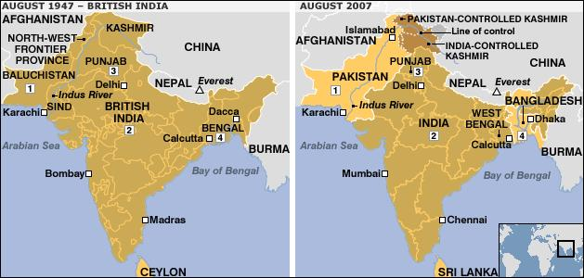
Subcontinent: Before and After the 1947 Partition

Slide 23

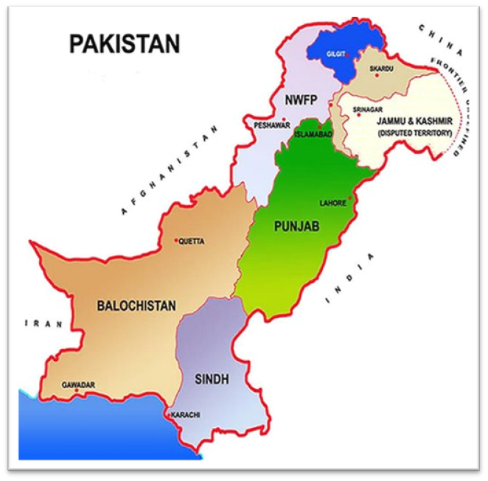
PAKISTAN is yours, ours, so love it, build it and strengthen it!

Slide 24
Do it With Unity, Faith and Discipline!

